Slide 1
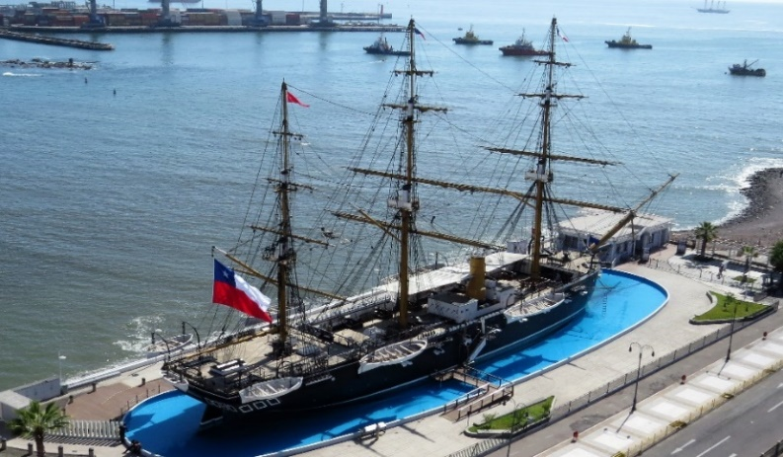
I quique, Chile
Corvette
Esmeralda
Museum
Project carried out and administered by

Slide 2
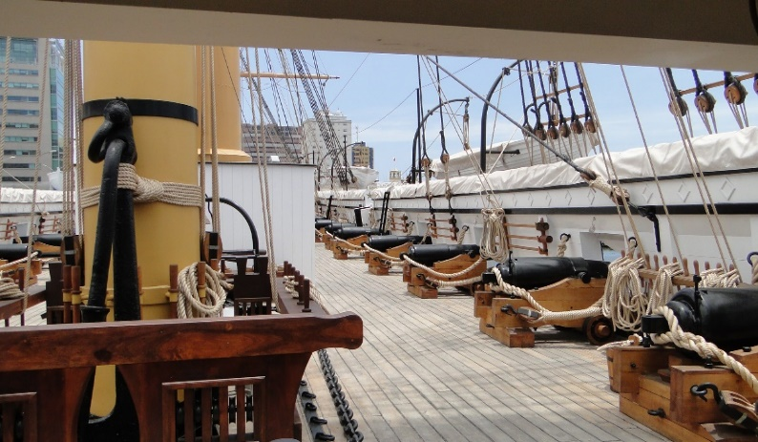
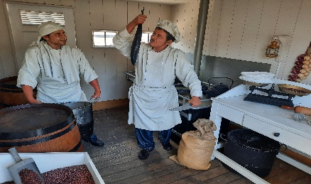
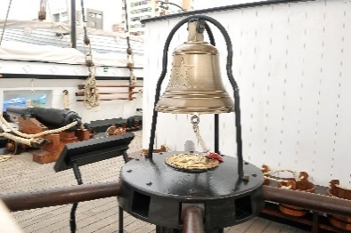
The life-size replica of the historic Chilean Navy warship, which gained lasting honor during the Naval Battle of Iquique on May 21st, 1879, is a heritage project made possible through the Cultural Donations Law. The initiative was funded by the Doña Inés de Collahuasi Mining Company and was managed and executed by the Chilean Maritime Heritage Corporation. The reconstruction represents faithfully the state of the ship as it was on May 20th, 1879, just one day before the historic battle.
WELCOME TO THE CORVETTE ESMERALDA MUSEUM
¿What will you find in the museum?
During your visit, you will have the opportunity to relive life aboard the Esmeralda during the time of Commander Agustín Arturo Prat Chacón. You will learn how the crew carried out their daily duties, discover where they slept, how they spent their free time, and what drills and exercises they performed—along with many other experiences that will transport you to the spirit of those glorious days.

Slide 3
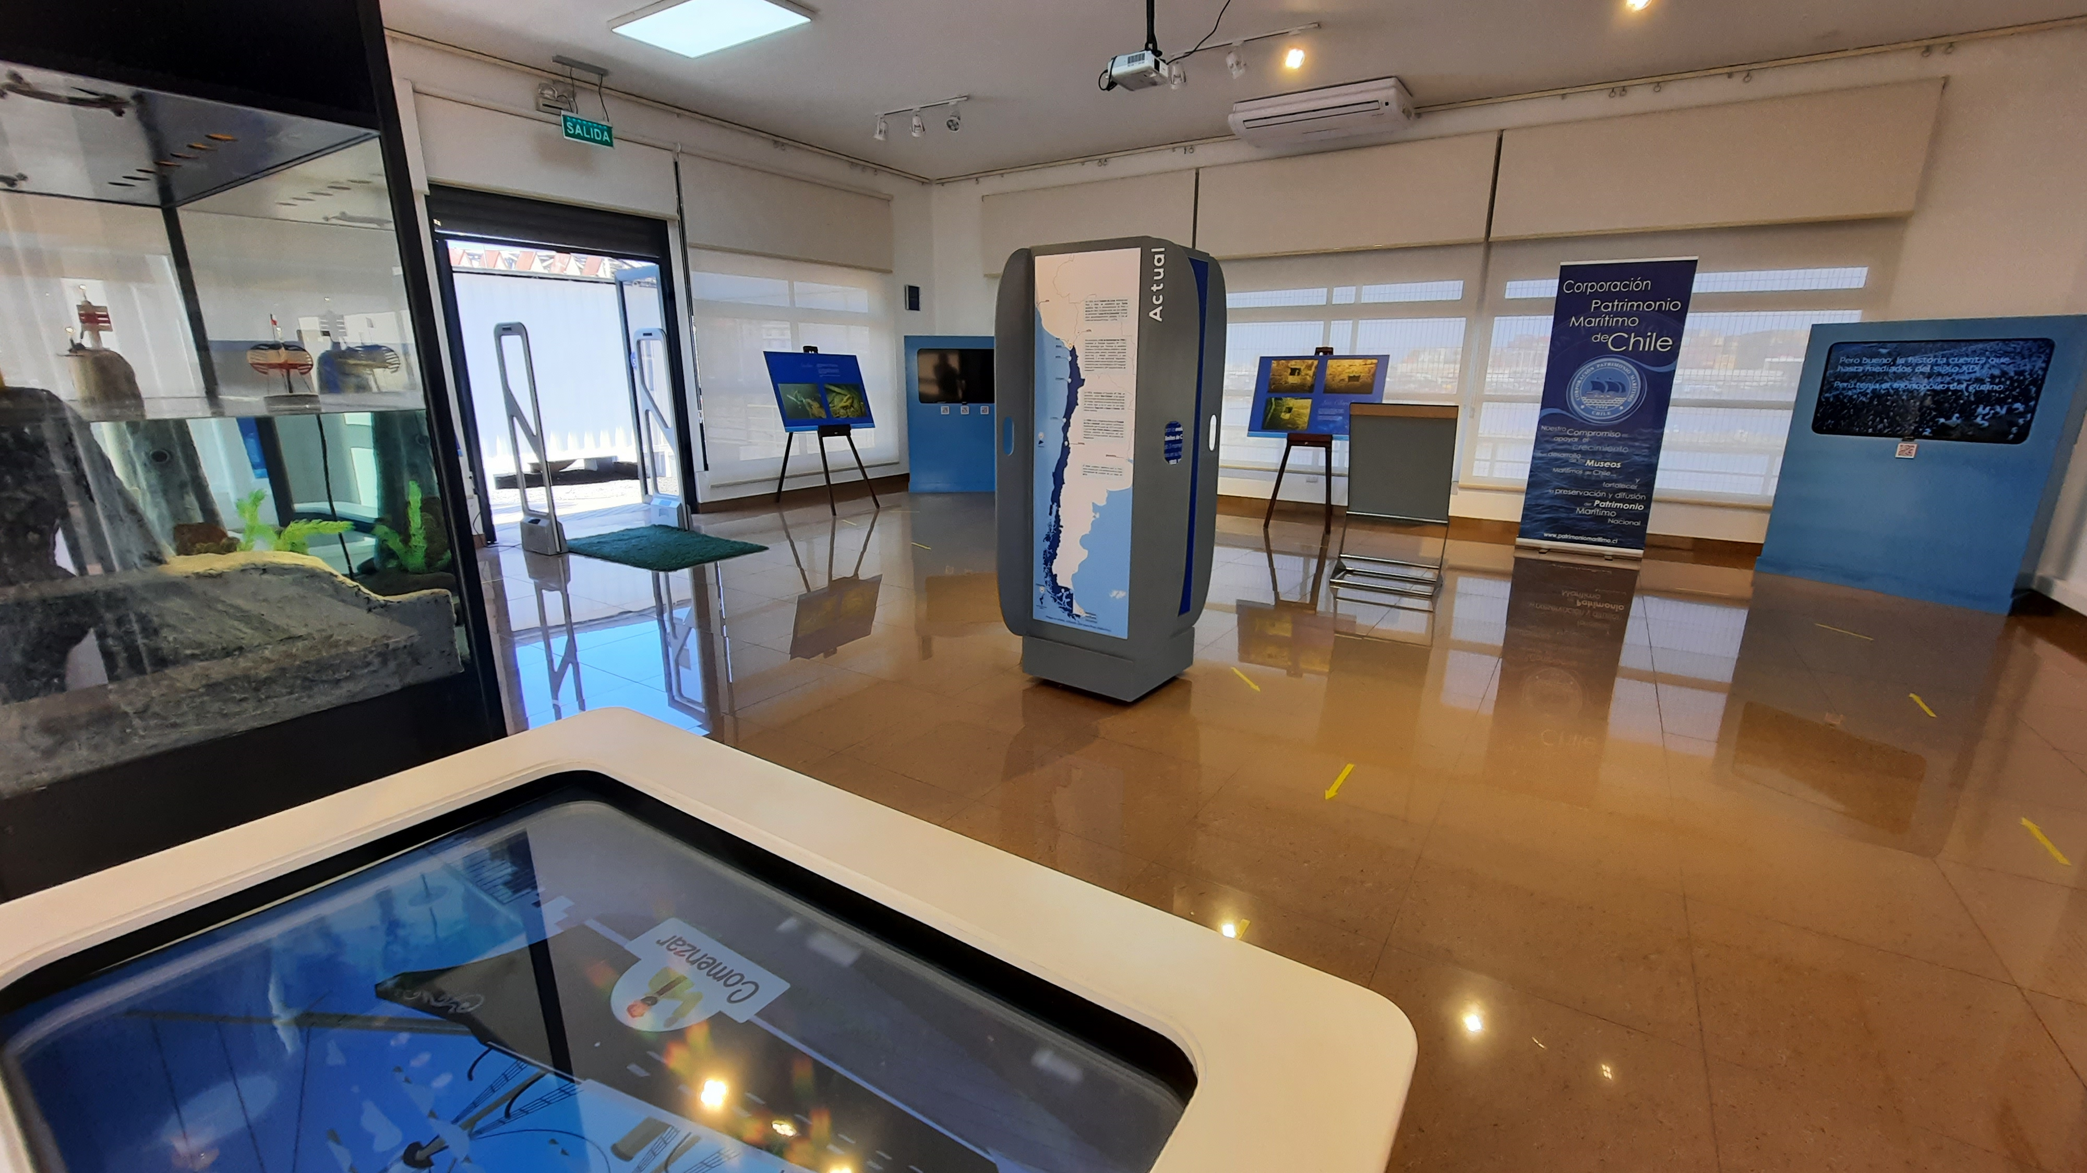
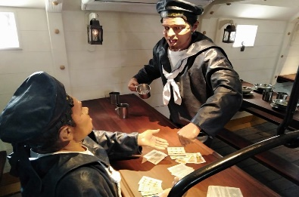
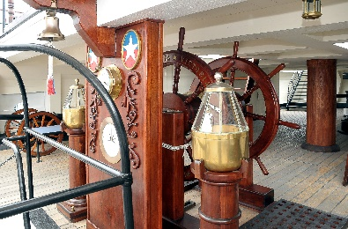
WELCOME TO THE CORVETTE ESMERALDA MUSEUM
The Tour
Your visit begins at the dock and continues through the living quarters deck, where you can explore the officers' cabins, the commander's quarters, and the lower deck—an area where the sailors ate and slept. During the day, folding benches and tables were used, and at night, they hanged hammocks for sleeping. Next, head up to the gun deck, where you’ll learn about the anchor handling system located at the forecastle (the highest point of the bow), and see the ship’s artillery and other key areas. Toward the stern, near the helm (steering wheel), you’ll find various nautical instruments and the propeller shaft well. Higher up is the quarterdeck, the place where Prat gave his rousing speech to the crew before boarding the Huáscar. As you descend via the starboard stairway, you'll arrive at the Souvenir Shop and the Maneuvers and Signals Courtyard. The tour ends in the Interactive Room, a space featuring visual and technological elements that make learning fun and engaging.

Slide 4
WELCOME TO THE CORVETTE ESMERALDA MUSEUM
Visitor Information & Reservations:
Website: www.museoesmeralda.cl . Phone: +56 57 2 248160
Hours
March to December
Tuesday to Sunday: Entry available on a first-come, first-served basis or with a reservation.
Opening hours: 10:00 AM – 1:30 PM and 3:00 PM – 5:00 PM
(On Tuesdays, the last tour at 4:00 PM)
Weekends: Entry on a first-come, first-served basis only — no reservations accepted.
Monday: Closed for maintenance.
Tour Options
Guided tours every 15 minutes, with groups up to 12 people.Audioguides available in multiple languages.
January and February
Monday: Entry on a first-come, first-served basis or with a reservation.
Opening hours: 10:00 AM – 1:30 PM and 3:00 PM – 5:00 PM
Tuesday to Sunday: Entry on a first-come, first-served basis or with a reservation.
Opening hours: 10:00 AM – 6:00 PM (continuous service)
Tour Options
Guided tours every 10 minutes, with groups up to 12 people.Audioguides available in multiple languages.
The museum has an elevator and a platform to assist visitors with reduced mobility. The spaces are wheelchair accessible.
Tourists | Guided tour | Audioguide Rental
Children under 6 | Free | + CLP $1,500
Children, Students, and Seniors | CLP $2,500
Adults | CLP $4,500
Foreigners Visitors and Tour Operators | CLP $5,500
Address: Avenida Arturo Prat S/N, Paseo Lynch, Iquique, Chile.

